Slide 1
NASH Ph3 Design Options
Fibrosis Improvement and Events

Slide 2
Ph3 NASH F4 Design
Dual primary endpoints
PE1: Fibrosis improvement (without worsening of NASH?)
PE2: Event-free survival (EFS)
Defined as time to first event of hard clinical events + intermediate events (e.g. portal hypertension, shift of risk group per combined NITs)?
Fallback testing strategy
Controlling overall type I error rate of 0.025 (1-sided)
1-sided p-values are considered
Testing PE1 at 1-sided 0.005 level
If significant, testing PE2 at 1-sided 0.025 level; otherwise, testing PE2 at 1-sided 0.02 level
Positive for PE1
Meet PE2: P ≤ 0.025?
Yes
No
Yes
Meet PE1: P ≤ 0.005?
Negative for PE2
Positive for PE2
No
No
Yes
Negative for PE1
Meet PE2: P ≤ 0.02?

Slide 3
Primary Endpoint 1: Fibrosis Improvement
Placebo Rate | Dropouts | True Tx Effect | 1-Sided Alpha = 0.025 |  |  | 1-Sided Alpha = 0.005 |  |  | 1-Sided Alpha = 0.0005
 |  | Placebo Rate | 80% | 85% | 90% | 80% | 85% | 90% | 80% | 85% | 90%
12% | 10% | 15% | 256 | 292 | 342 | 384 | 430 | 488 | 572 | 624 | 692
 |  | 20% | 158 | 180 | 208 | 236 | 262 | 300 | 354 | 382 | 424
 | 15% | 15% | 274 | 314 | 366 | 416 | 462 | 524 | 616 | 670 | 742
 |  | 20% | 170 | 192 | 224 | 250 | 284 | 322 | 376 | 408 | 456
20% | 10% | 15% | 332 | 380 | 444 | 500 | 556 | 632 | 734 | 802 | 894
 |  | 20% | 198 | 224 | 262 | 296 | 330 | 374 | 436 | 476 | 528
 | 15% | 15% | 360 | 408 | 480 | 540 | 600 | 680 | 792 | 866 | 964
 |  | 20% | 212 | 242 | 284 | 320 | 354 | 404 | 472 | 514 | 572
28% | 10% | 15% | 388 | 444 | 518 | 582 | 650 | 736 | 852 | 934 | 1040
 |  | 20% | 226 | 256 | 300 | 338 | 376 | 426 | 496 | 542 | 604
 | 15% | 15% | 422 | 482 | 564 | 632 | 706 | 802 | 926 | 1016 | 1132
 |  | 20% | 246 | 282 | 326 | 368 | 412 | 466 | 542 | 592 | 658
3:2 randomization; Missing data imputed with non-responder imputation method (NRI)

Slide 4
Primary Endpoint 2: EFS (accrual rate 400/yr, FU till LPFV + 4 yr)
3:2 randomization, Power = 80%, Logrank test
1-Sided Alpha | Placebo EFS at 2 Yrs | HR | Dropout at 2 Yrs | Total Sample Size | Accrual (yr) | Study Duration (yr) | Expected # of Events
0.02 | 0.87 | 0.65 | 0.10 | 849 | 2.1 | 6.1 | 181
 |  |  | 0.15 | 899 | 2.2 | 6.2 | 181
 |  | 0.70 | 0.10 | 1141 | 2.9 | 6.9 | 264
 |  |  | 0.15 | 1213 | 3.0 | 7.0 | 264
 |  | 0.75 | 0.10 | 1594 | 4.0 | 8.0 | 408
 |  |  | 0.15 | 1701 | 4.3 | 8.3 | 408
 | 0.90 | 0.65 | 0.10 | 1049 | 2.6 | 6.6 | 181
 |  |  | 0.15 | 1113 | 2.8 | 6.8 | 181
 |  | 0.70 | 0.10 | 1397 | 3.5 | 7.5 | 264
 |  |  | 0.15 | 1488 | 3.7 | 7.7 | 264
 |  | 0.75 | 0.10 | 1933 | 4.8 | 8.8 | 407
 |  |  | 0.15 | 2069 | 5.2 | 9.2 | 408
0.025 | 0.87 | 0.65 | 0.10 | 803 | 2.0 | 6.0 | 169
 |  |  | 0.15 | 849 | 2.1 | 6.1 | 169
 |  | 0.70 | 0.10 | 1081 | 2.7 | 6.7 | 248
 |  |  | 0.15 | 1145 | 2.9 | 6.9 | 247
 |  | 0.75 | 0.10 | 1513 | 3.8 | 7.8 | 382
 |  |  | 0.15 | 1611 | 4.0 | 8.0 | 382
 | 0.90 | 0.65 | 0.10 | 991 | 2.5 | 6.5 | 169
 |  |  | 0.15 | 1052 | 2.6 | 6.6 | 169
 |  | 0.70 | 0.10 | 1324 | 3.3 | 7.3 | 247
 |  |  | 0.15 | 1407 | 3.5 | 7.5 | 247
 |  | 0.75 | 0.10 | 1835 | 4.6 | 8.6 | 382
 |  |  | 0.15 | 1961 | 4.9 | 8.9 | 382

Slide 5
Primary Endpoint 2: EFS (accrual rate 400/yr, FU till LPFV + 5 yr)
3:2 randomization, Power = 80%, Logrank test
1-Sided Alpha | Placebo EFS at 2 Yrs | HR | Dropout at 2 Yrs | Total Sample Size | Accrual (yr) | Study Duration (yr) | Expected # of Events
0.02 | 0.87 | 0.65 | 0.10 | 755 | 1.9 | 6.9 | 181
 |  |  | 0.15 | 808 | 2.0 | 7.0 | 181
 |  | 0.70 | 0.10 | 1027 | 2.6 | 7.6 | 264
 |  |  | 0.15 | 1103 | 2.8 | 7.8 | 265
 |  | 0.75 | 0.10 | 1459 | 3.6 | 8.6 | 408
 |  |  | 0.15 | 1569 | 3.9 | 8.9 | 408
 | 0.90 | 0.65 | 0.10 | 935 | 2.3 | 7.3 | 181
 |  |  | 0.15 | 1005 | 2.5 | 7.5 | 181
 |  | 0.70 | 0.10 | 1263 | 3.2 | 8.2 | 264
 |  |  | 0.15 | 1359 | 3.4 | 8.4 | 264
 |  | 0.75 | 0.10 | 1776 | 4.4 | 9.4 | 408
 |  |  | 0.15 | 1916 | 4.8 | 9.8 | 408
0.025 | 0.87 | 0.65 | 0.10 | 711 | 1.8 | 6.8 | 169
 |  |  | 0.15 | 761 | 1.9 | 6.9 | 169
 |  | 0.70 | 0.10 | 969 | 2.4 | 7.4 | 247
 |  |  | 0.15 | 1039 | 2.6 | 7.6 | 247
 |  | 0.75 | 0.10 | 1379 | 3.4 | 8.4 | 382
 |  |  | 0.15 | 1481 | 3.7 | 8.7 | 382
 | 0.90 | 0.65 | 0.10 | 883 | 2.2 | 7.2 | 169
 |  |  | 0.15 | 947 | 2.4 | 7.4 | 169
 |  | 0.70 | 0.10 | 1193 | 3.0 | 8.0 | 247
 |  |  | 0.15 | 1283 | 3.2 | 8.2 | 247
 |  | 0.75 | 0.10 | 1681 | 4.2 | 9.2 | 382
 |  |  | 0.15 | 1813 | 4.5 | 9.5 | 382

Slide 6
Back Up

Slide 7
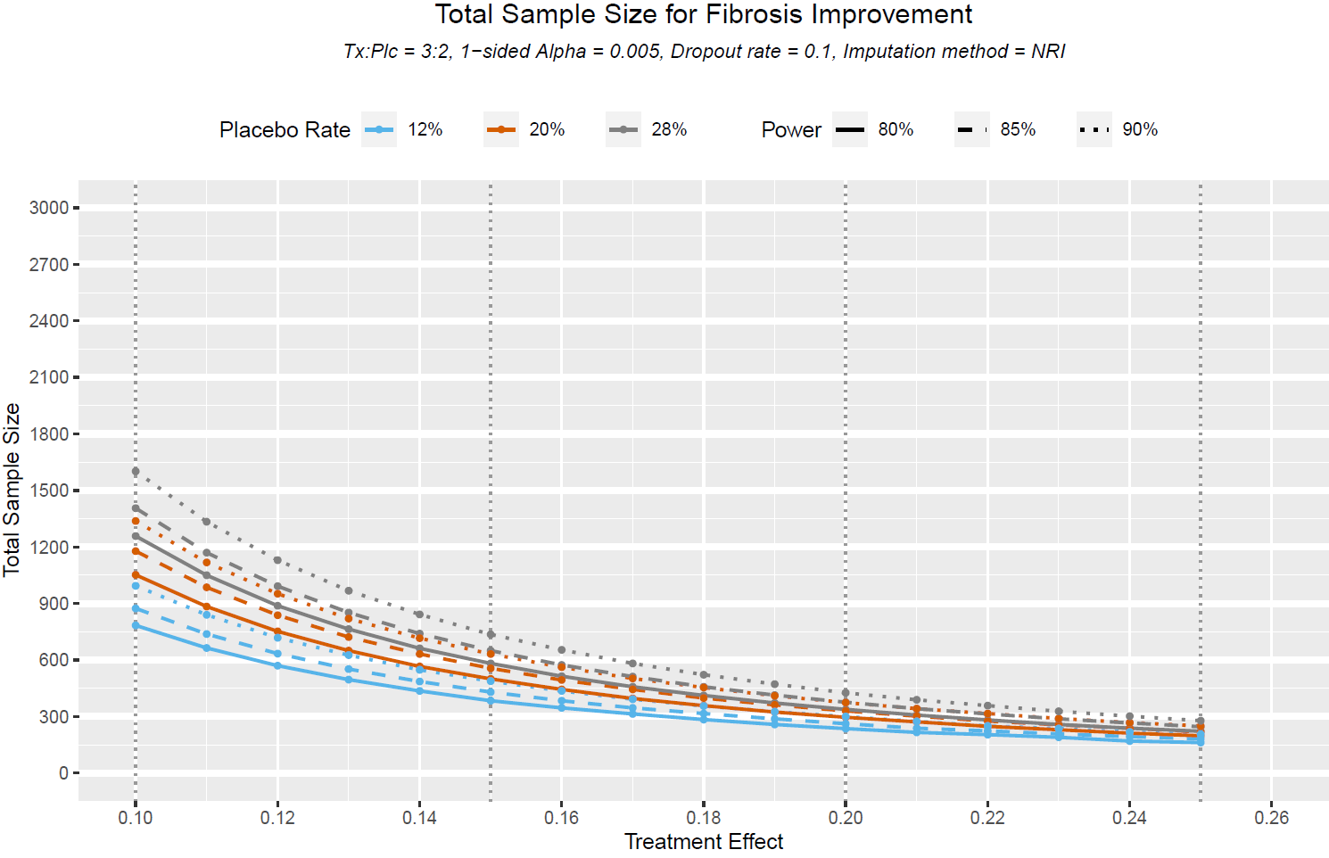

Slide 8
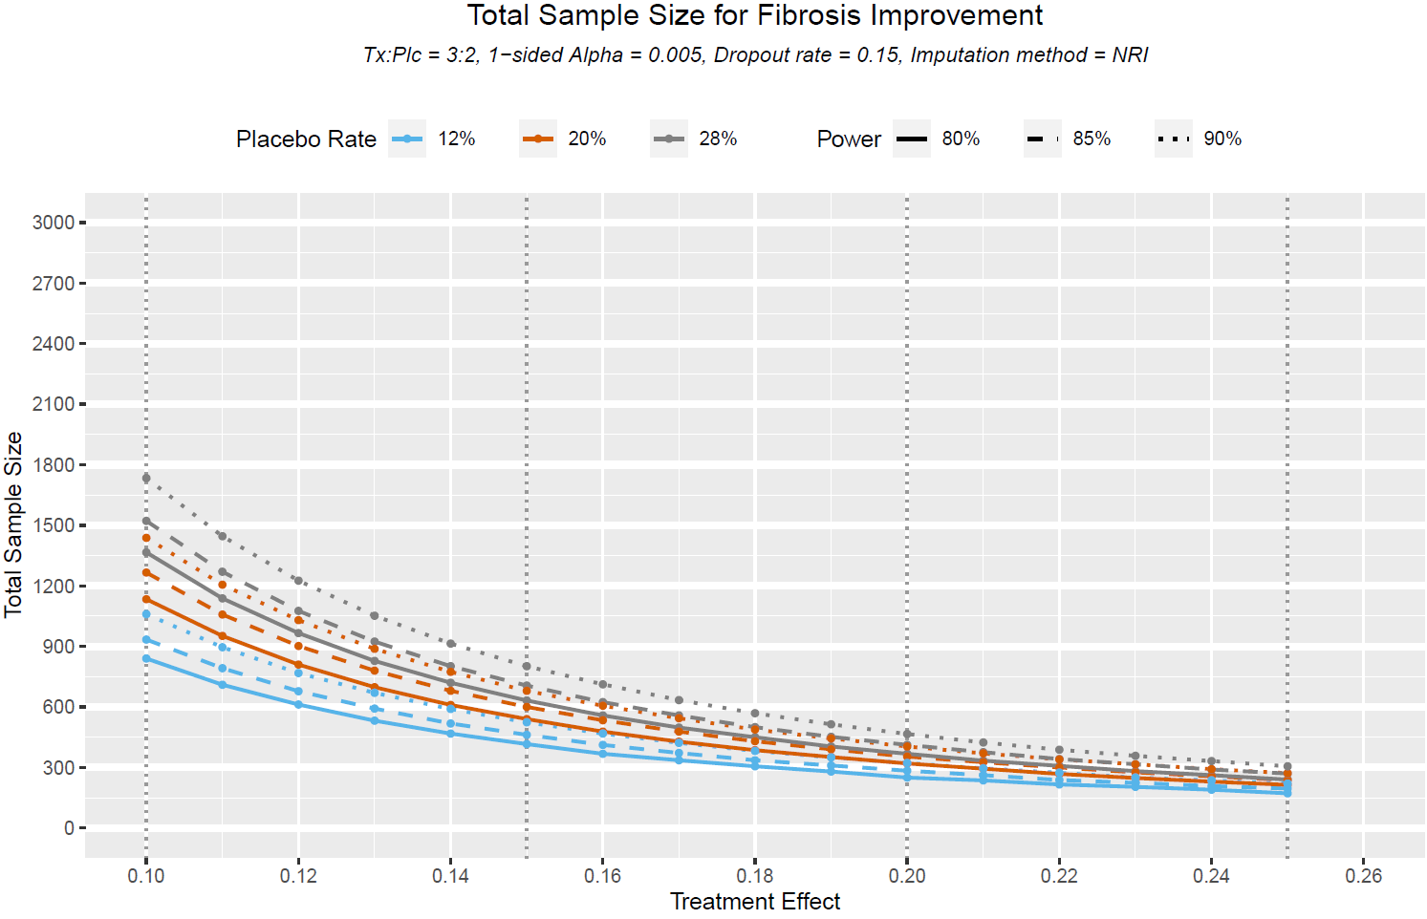

Slide 9
Ph3 Sample Size for Fibrosis Improvement
Placebo Rate | Dropouts | True Tx Effect | 1-Sided Alpha = 0.025 |  |  | 1-Sided Alpha = 0.005 |  |  | 1-Sided Alpha = 0.0005
 |  | Placebo Rate | 80% | 85% | 90% | 80% | 85% | 90% | 80% | 85% | 90%
12% | 10% | 15% | 270 | 308 | 362 | 408 | 454 | 514 | 602 | 658 | 730
 |  | 20% | 164 | 188 | 218 | 246 | 274 | 312 | 368 | 400 | 444
 | 15% | 15% | 300 | 344 | 396 | 450 | 502 | 570 | 664 | 724 | 806
 |  | 20% | 182 | 208 | 240 | 274 | 304 | 346 | 404 | 442 | 488
20% | 10% | 15% | 350 | 398 | 468 | 526 | 584 | 664 | 772 | 844 | 938
 |  | 20% | 206 | 234 | 274 | 308 | 344 | 390 | 454 | 496 | 552
 | 15% | 15% | 392 | 444 | 518 | 584 | 652 | 740 | 856 | 938 | 1044
 |  | 20% | 226 | 262 | 306 | 342 | 382 | 436 | 504 | 552 | 614
28% | 10% | 15% | 406 | 464 | 542 | 606 | 676 | 770 | 888 | 972 | 1086
 |  | 20% | 232 | 266 | 312 | 350 | 388 | 442 | 512 | 562 | 624
 | 15% | 15% | 452 | 516 | 604 | 676 | 756 | 860 | 992 | 1086 | 1210
 |  | 20% | 258 | 296 | 348 | 388 | 434 | 494 | 572 | 624 | 696
3:2 randomization; Missing data imputed with reference-based imputation method (RBI)

Slide 10
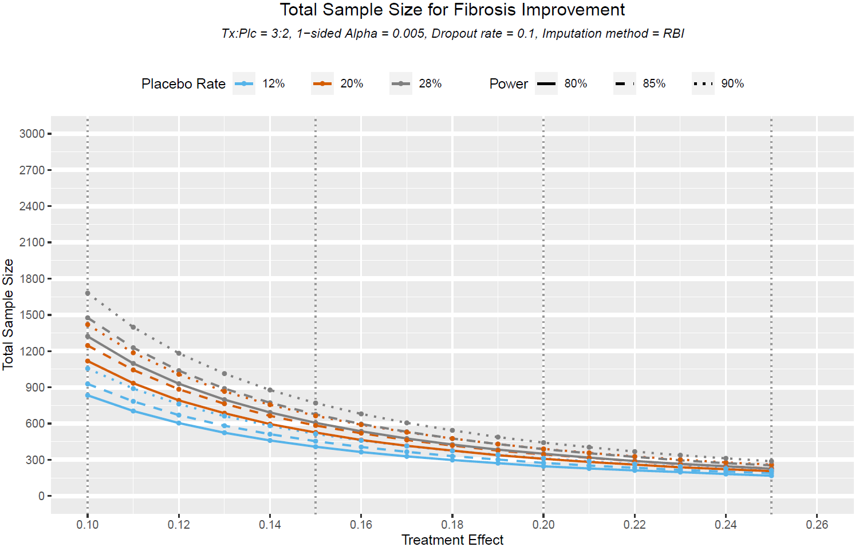

Slide 11
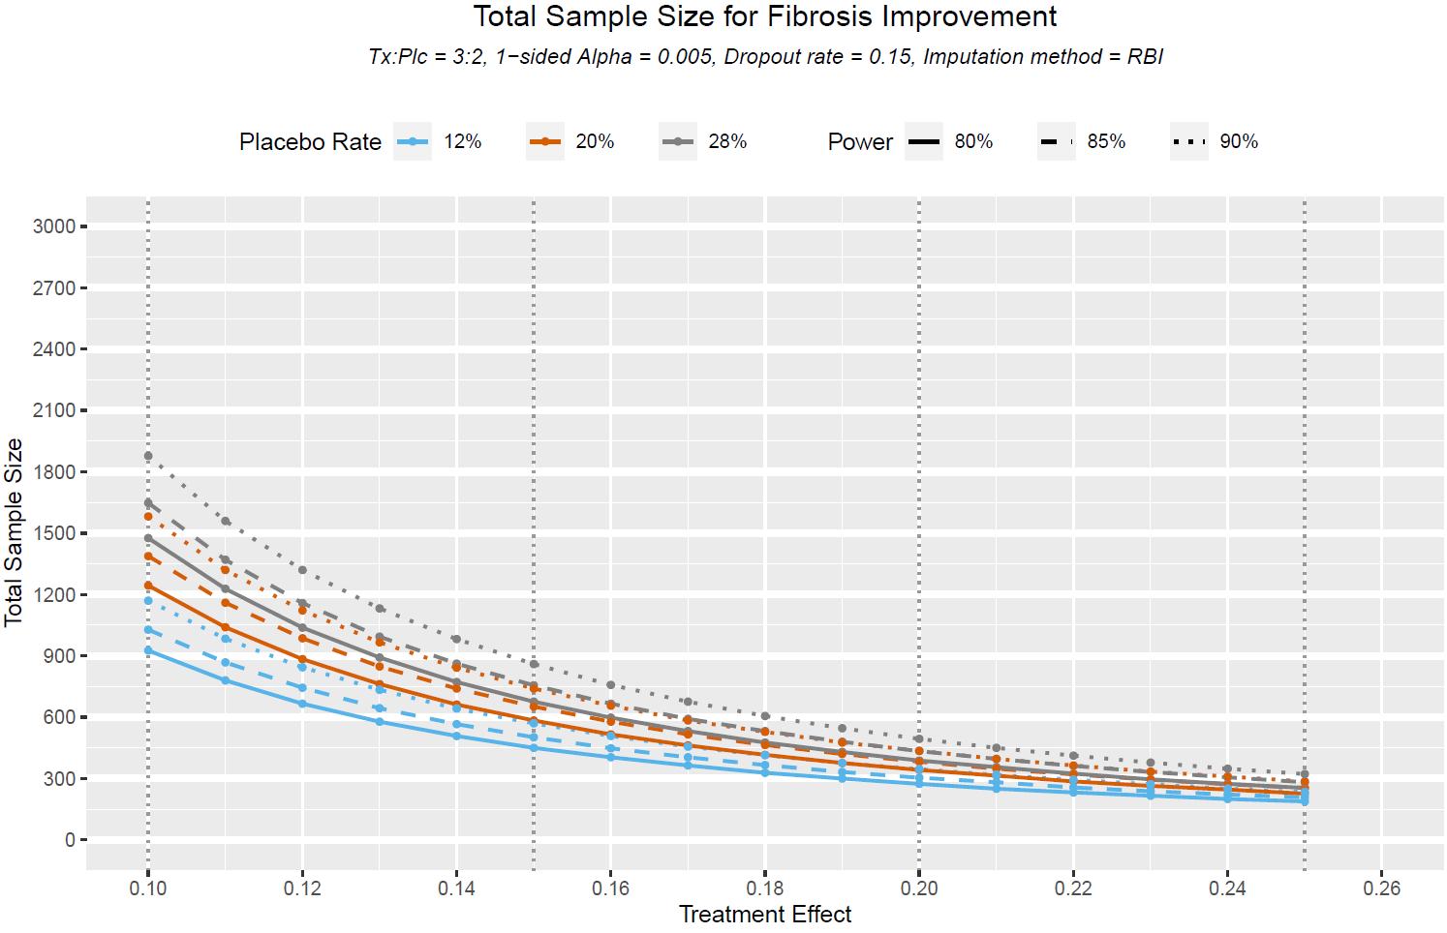

Slide 12
Primary Endpoint 2: EFS (accrual rate 800/yr, FU till LPFV + 4 yr)
3:2 randomization, Power = 80%, Logrank test
1-Sided Alpha | Placebo EFS at 2 Yrs | HR | Dropout at 2 Yrs | Total Sample Size | Accrual (yr) | Study Duration (yr) | Expected # of Events
0.02 | 0.87 | 0.65 | 0.10 | 915 | 1.1 | 5.1 | 181
 |  |  | 0.15 | 967 | 1.2 | 5.2 | 181
 |  | 0.70 | 0.10 | 1251 | 1.6 | 5.6 | 264
 |  |  | 0.15 | 1321 | 1.7 | 5.7 | 264
 |  | 0.75 | 0.10 | 1779 | 2.2 | 6.2 | 408
 |  |  | 0.15 | 1885 | 2.4 | 6.4 | 408
 | 0.90 | 0.65 | 0.10 | 1147 | 1.4 | 5.4 | 181
 |  |  | 0.15 | 1213 | 1.5 | 5.5 | 181
 |  | 0.70 | 0.10 | 1555 | 1.9 | 5.9 | 264
 |  |  | 0.15 | 1646 | 2.1 | 6.1 | 264
 |  | 0.75 | 0.10 | 2190 | 2.7 | 6.7 | 407
 |  |  | 0.15 | 2325 | 2.9 | 6.9 | 407
0.025 | 0.87 | 0.65 | 0.10 | 861 | 1.1 | 5.1 | 169
 |  |  | 0.15 | 909 | 1.1 | 5.1 | 169
 |  | 0.70 | 0.10 | 1179 | 1.5 | 5.5 | 247
 |  |  | 0.15 | 1246 | 1.6 | 5.6 | 247
 |  | 0.75 | 0.10 | 1681 | 2.1 | 6.1 | 382
 |  |  | 0.15 | 1779 | 2.2 | 6.2 | 382
 | 0.90 | 0.65 | 0.10 | 1081 | 1.4 | 5.4 | 169
 |  |  | 0.15 | 1143 | 1.4 | 5.4 | 169
 |  | 0.70 | 0.10 | 1467 | 1.8 | 5.8 | 247
 |  |  | 0.15 | 1553 | 1.9 | 5.9 | 247
 |  | 0.75 | 0.10 | 2073 | 2.6 | 6.6 | 382
 |  |  | 0.15 | 2199 | 2.7 | 6.7 | 382

Slide 13
Primary Endpoint 2: EFS (accrual rate 800/yr, FU till LPFV + 5 yr)
3:2 randomization, Power = 80%, Logrank test
1-Sided Alpha | Placebo EFS at 2 Yrs | HR | Dropout at 2 Yrs | Total Sample Size | Accrual (yr) | Study Duration (yr) | Expected # of Events
0.02 | 0.87 | 0.65 | 0.10 | 793 | 1.0 | 6.0 | 180
 |  |  | 0.15 | 851 | 1.1 | 6.1 | 181
 |  | 0.70 | 0.10 | 1100 | 1.4 | 6.4 | 264
 |  |  | 0.15 | 1175 | 1.5 | 6.5 | 264
 |  | 0.75 | 0.10 | 1586 | 2.0 | 7.0 | 408
 |  |  | 0.15 | 1697 | 2.1 | 7.1 | 408
 | 0.90 | 0.65 | 0.10 | 1001 | 1.3 | 6.3 | 181
 |  |  | 0.15 | 1069 | 1.3 | 6.3 | 181
 |  | 0.70 | 0.10 | 1371 | 1.7 | 6.7 | 264
 |  |  | 0.15 | 1467 | 1.8 | 6.8 | 264
 |  | 0.75 | 0.10 | 1961 | 2.5 | 7.5 | 408
 |  |  | 0.15 | 2104 | 2.6 | 7.6 | 408
0.025 | 0.87 | 0.65 | 0.10 | 750 | 0.9 | 5.9 | 169
 |  |  | 0.15 | 799 | 1.0 | 6.0 | 169
 |  | 0.70 | 0.10 | 1035 | 1.3 | 6.3 | 247
 |  |  | 0.15 | 1105 | 1.4 | 6.4 | 247
 |  | 0.75 | 0.10 | 1495 | 1.9 | 6.9 | 382
 |  |  | 0.15 | 1599 | 2.0 | 7.0 | 382
 | 0.90 | 0.65 | 0.10 | 941 | 1.2 | 6.2 | 169
 |  |  | 0.15 | 1007 | 1.3 | 6.3 | 169
 |  | 0.70 | 0.10 | 1291 | 1.6 | 6.6 | 247
 |  |  | 0.15 | 1383 | 1.7 | 6.7 | 247
 |  | 0.75 | 0.10 | 1851 | 2.3 | 7.3 | 382
 |  |  | 0.15 | 1979 | 2.5 | 7.5 | 383

